Slide 1
Bit.Xpo.webapi

Slide 2






Traditional XPO architecture
MySQL
Session
SAP HANA
IBM DB2 For I
Network
(Tcp/IP)
Data Layer (IDal)
XPO providers
Unit Of Work

Slide 3



XPO web api Middle tier architecture
MySQL
Session
XPO.Web.API (HTTP
or HTTPS)
SAP HANA
IBM DB2 For I
Data Layer
(IDal)
Network
(Tcp/IP)
Jwt
token
XPO providers
Unit Of Work
Any authentication server that produce a token

Slide 4






XPO web api Clients
Session
XPO.Web.API
Network
Data Layer (IDal)
Unit Of Work

Slide 5
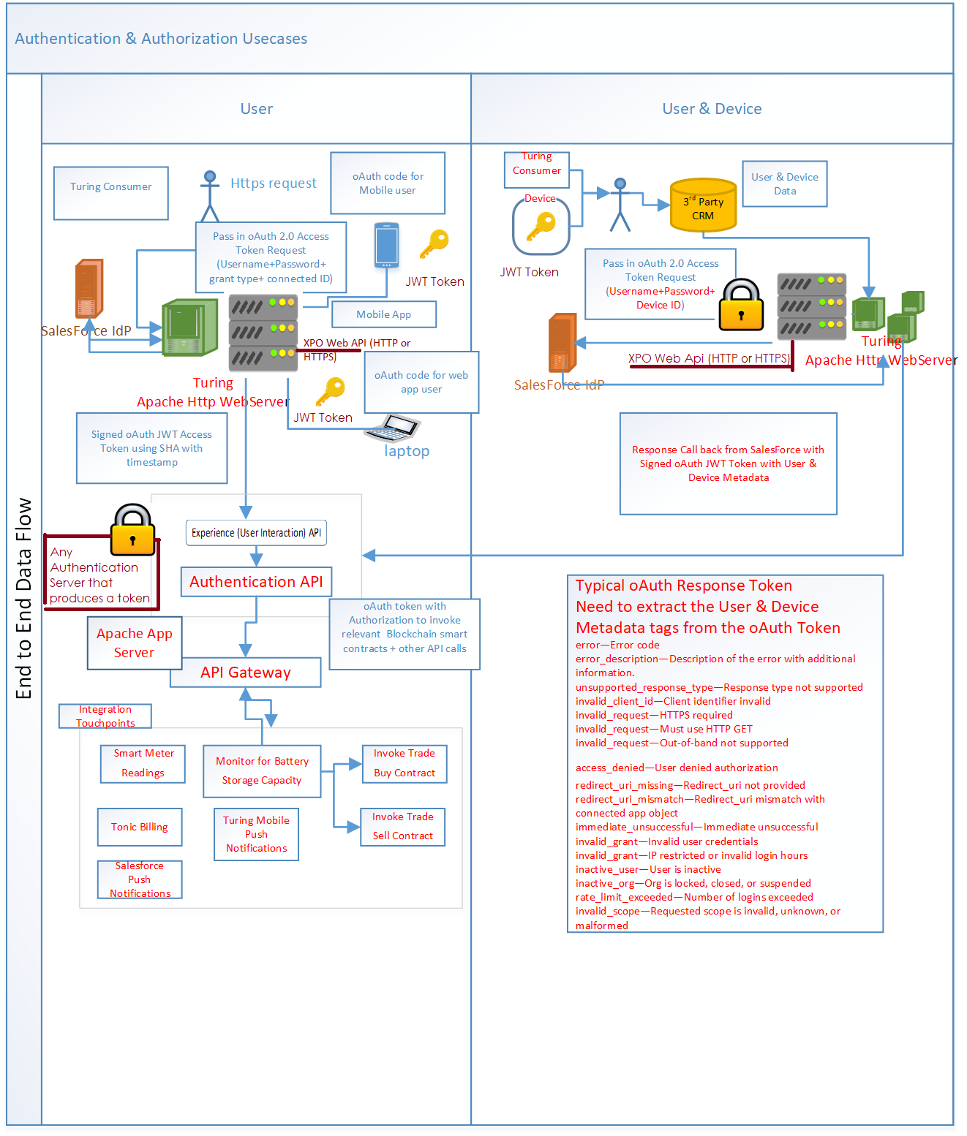
XPO web api Middle tier architecture
MySQL
Session
XPO.Web.API (HTTP
or HTTPS)
SAP HANA
IBM DB2 For I
Data Layer
(IDal)
Network
(Tcp/IP)
Jwt
token
XPO providers
Unit Of Work
Any authentication server that produce a token

